Slide 1
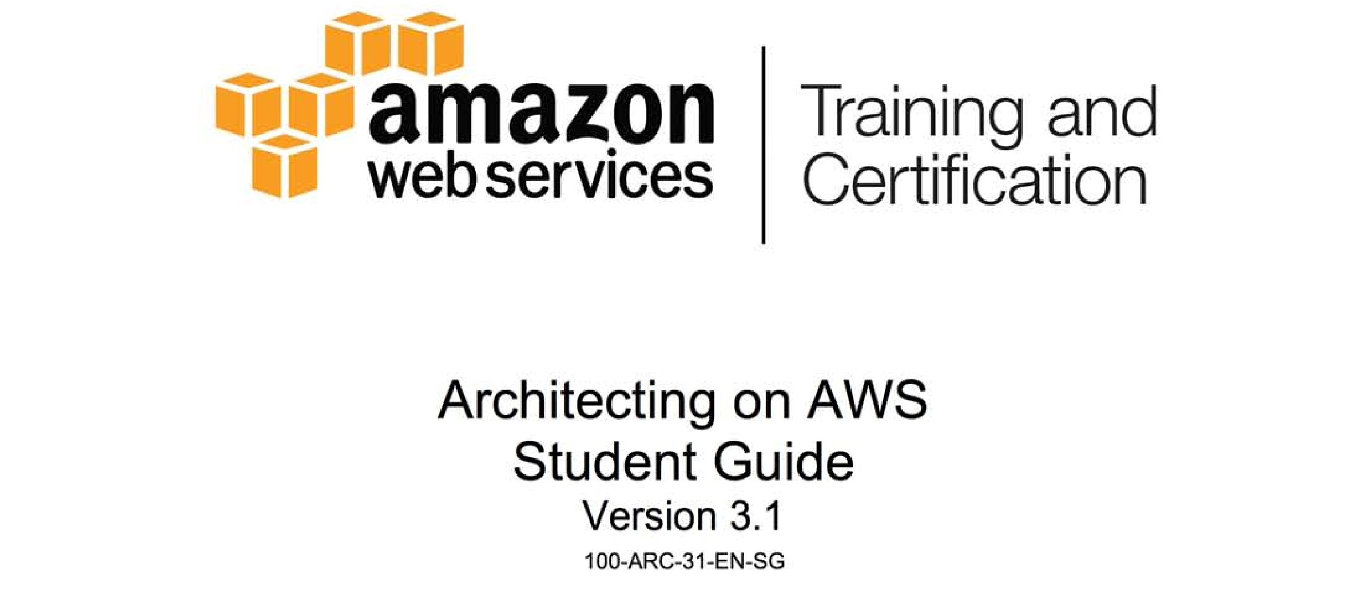

Slide 2

Module 5: Identity, Authentication, and Authorization

Slide 3
Topics
Authentication, authorization, and where they apply
AWS Identity and Access Management (IAM)
Amazon Cognito

Slide 4
Authentication, authorization, and where they apply
The three major realms where authentication and authorization
Occur within AWS
Multi-factor authentication and how to implement it
Your AWS master account
Creating users and groups with IAM
The role of authorization policies

Slide 5
The three realms: WordPress example
We want to run WordPress on AWS
1. Login to management console and launch EC2 instance
-> Management lever authentication and authentication
2. Login to instance, install WordPress and configure DB connection
-> component level authentication and authentication
3. Login to Word press and write a blog post
-> Application level authentication and authentication

Slide 6
Login to Management console and launch EC2 instance
Authentication and authorization to AWS APIs:
Everything is an API at AWS
You have to make authenticated API requests
Examples of API requests:
EC2 -> RunInstance

Slide 7
Login to instance, install WordPress and configure DB connection
Authentication and authorization to OS:
Local Linux user (for example: roor@, ubuntu@, ec2-user@ )
Local Windows user (Administrator)
Authentication and authorization to database:
MySQL username and password
SQL Server username and password

Slide 8
Login to WordPress and write a blog post
Authentication and authorization to the application:
WordPress authentication to a database
Some applications authenticate to Active Directory
Others authenticate via Oauth 2.0 and so on

Slide 9
WordPress Example
Task | Can AWS help
Login to Management console and launch EC2 Instance | Yes, a lot
Login to instance, install WordPress and configure DB connection | Yes, some
Login to WordPress and write a blog post | Depends on the application

Slide 10
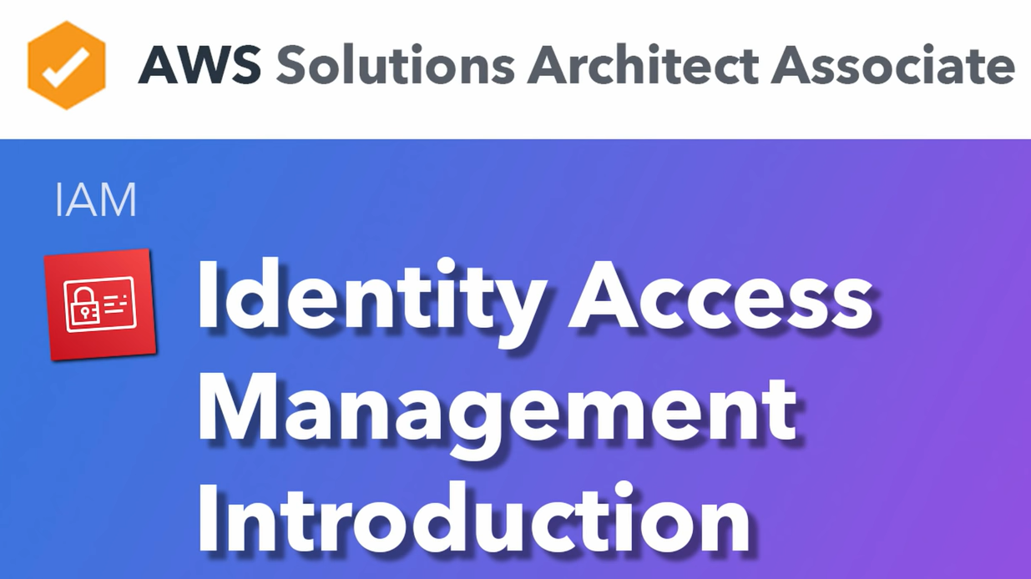

Slide 11
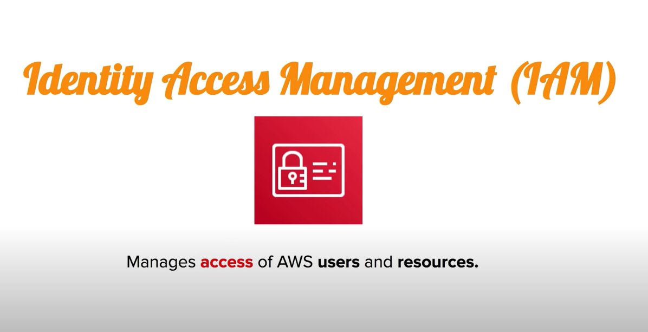

Slide 12


Slide 13
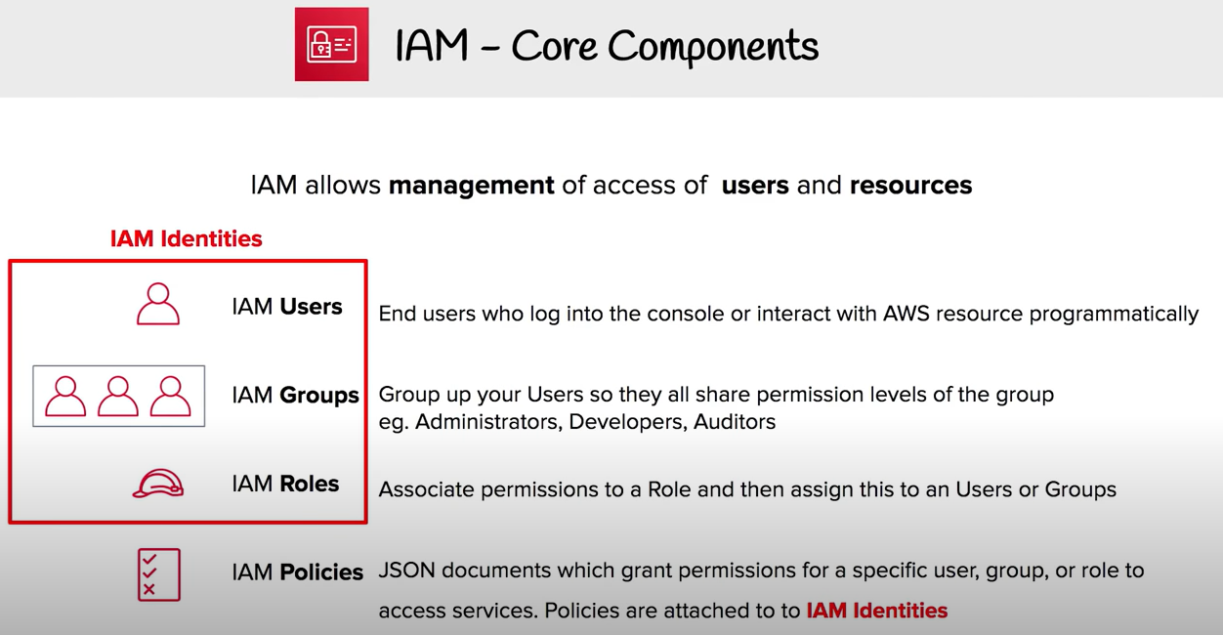

Slide 14
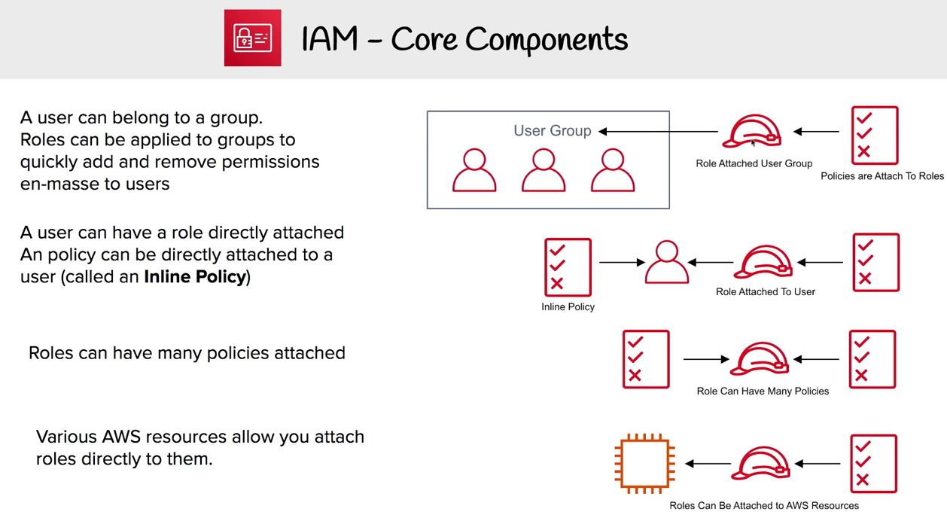

Slide 15
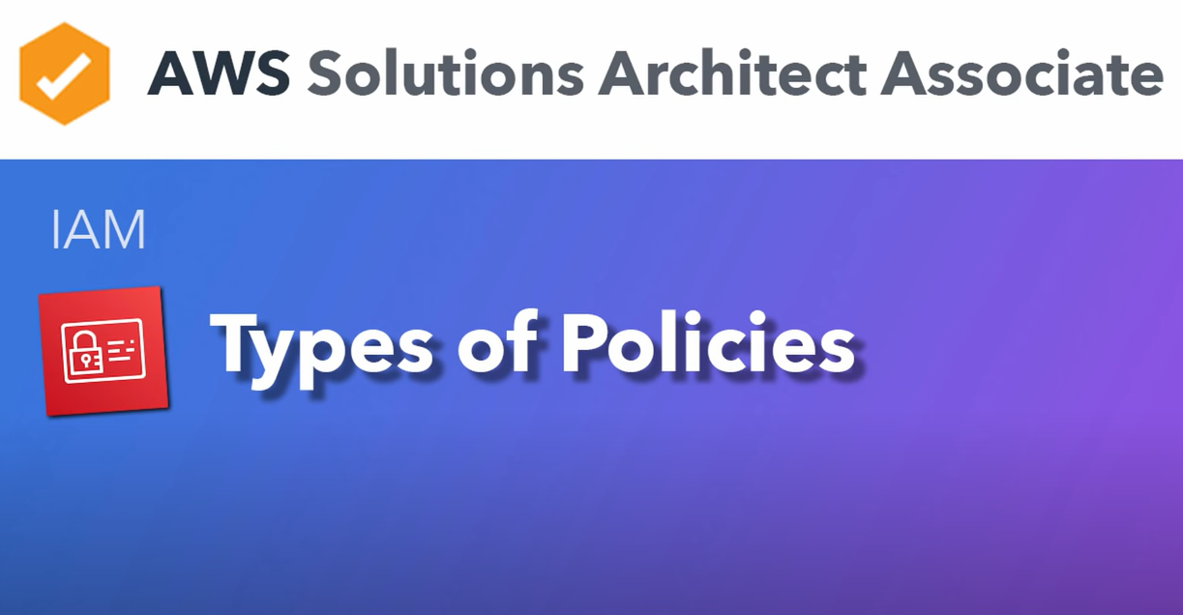

Slide 16
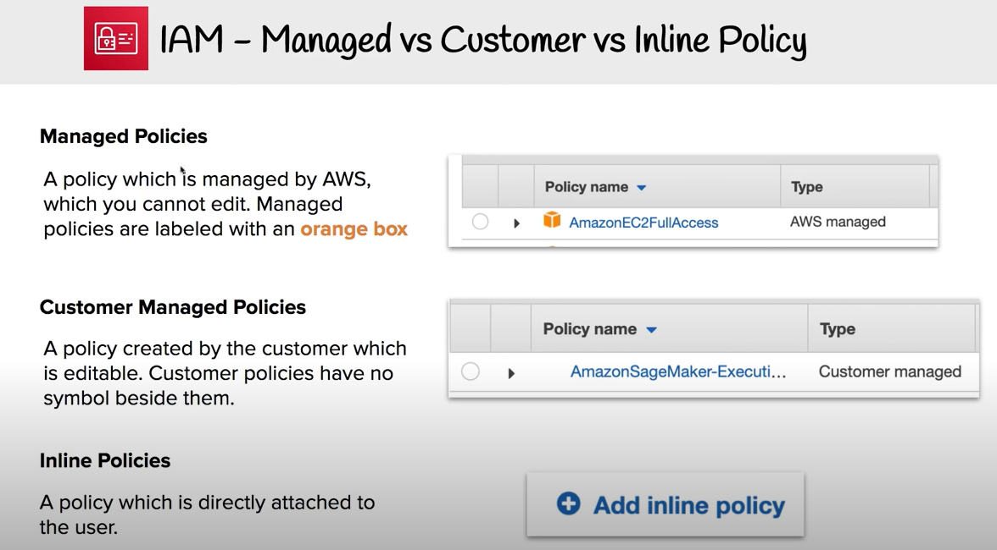

Slide 17
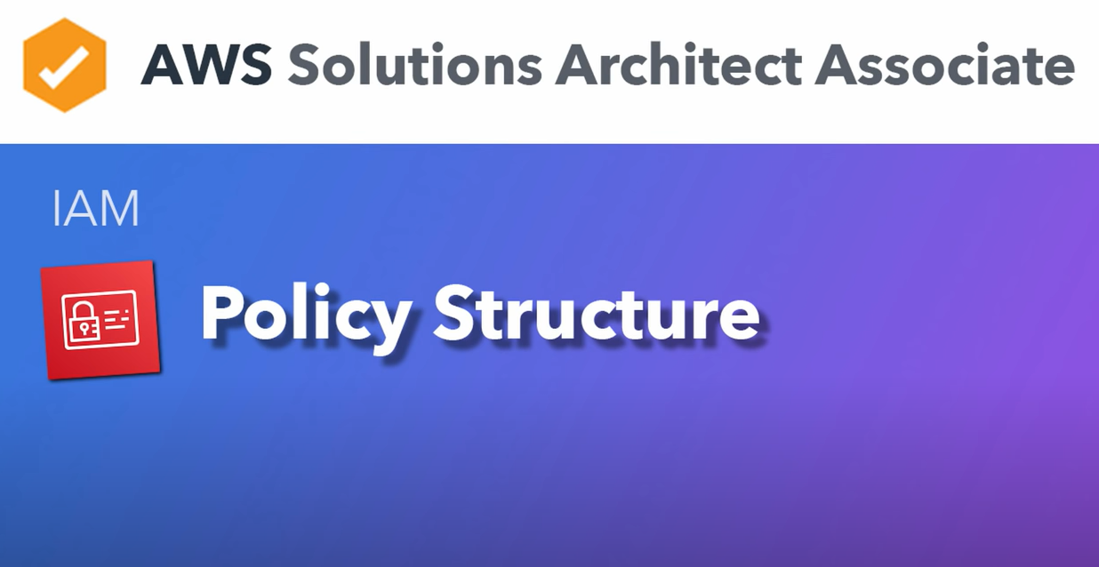

Slide 18
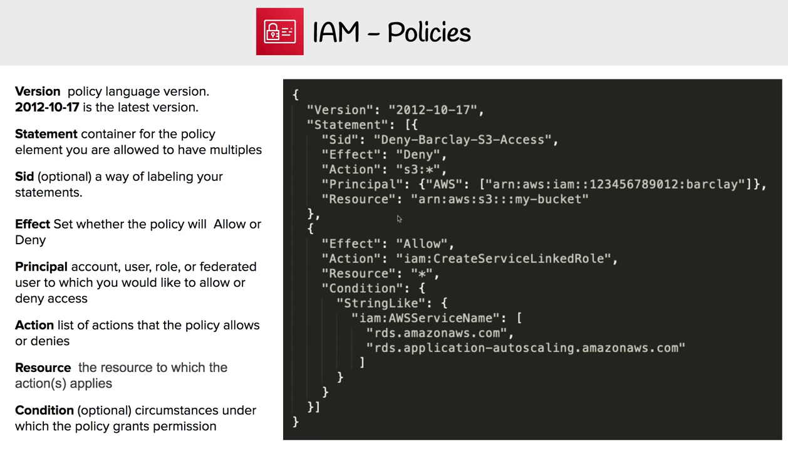

Slide 19


Slide 20
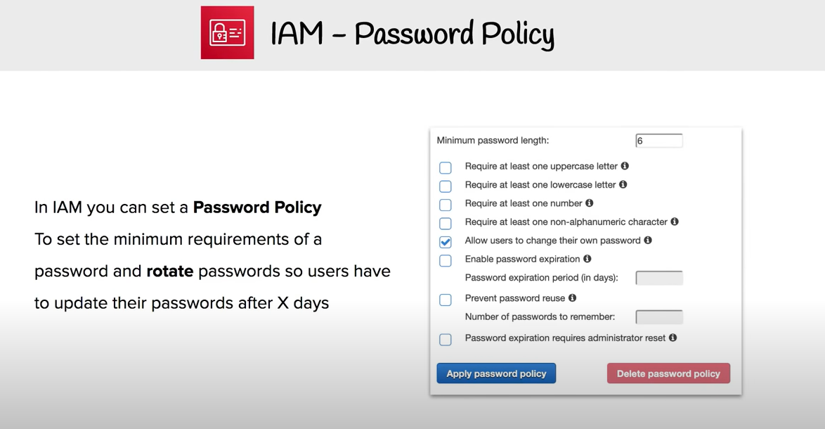

Slide 21
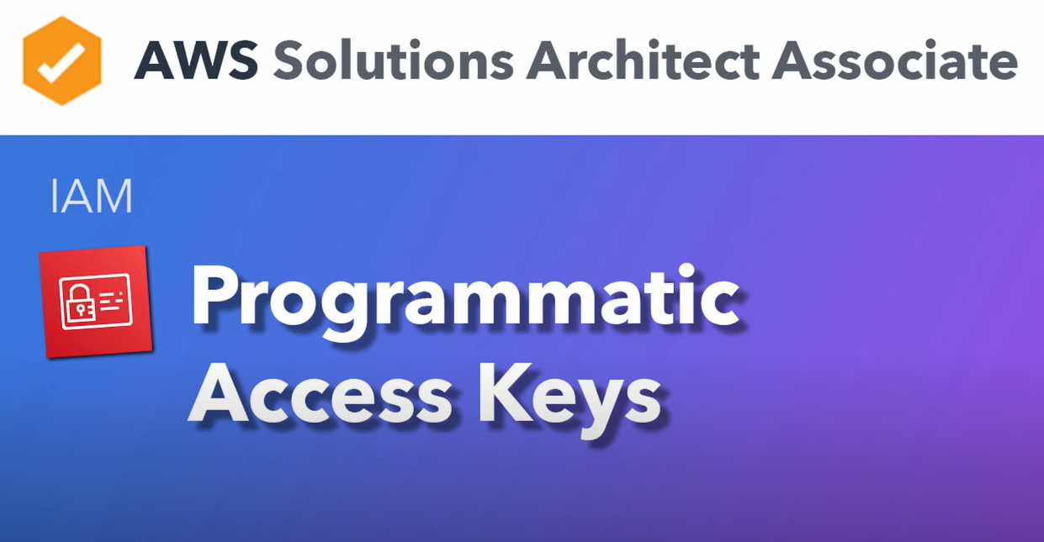

Slide 22
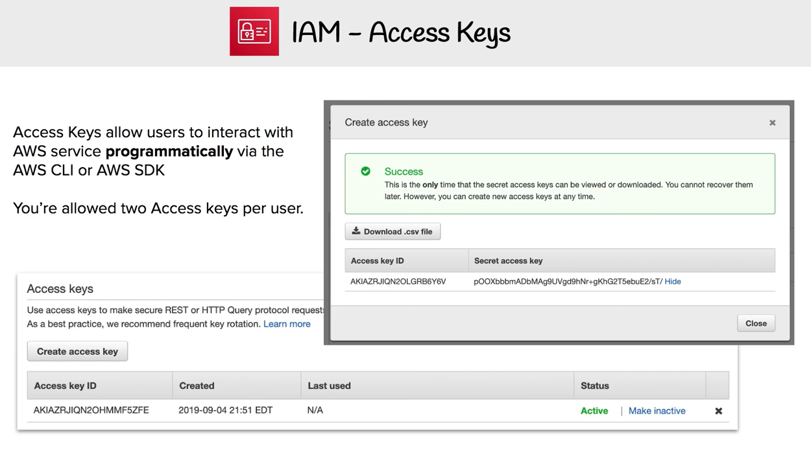

Slide 23


Slide 24
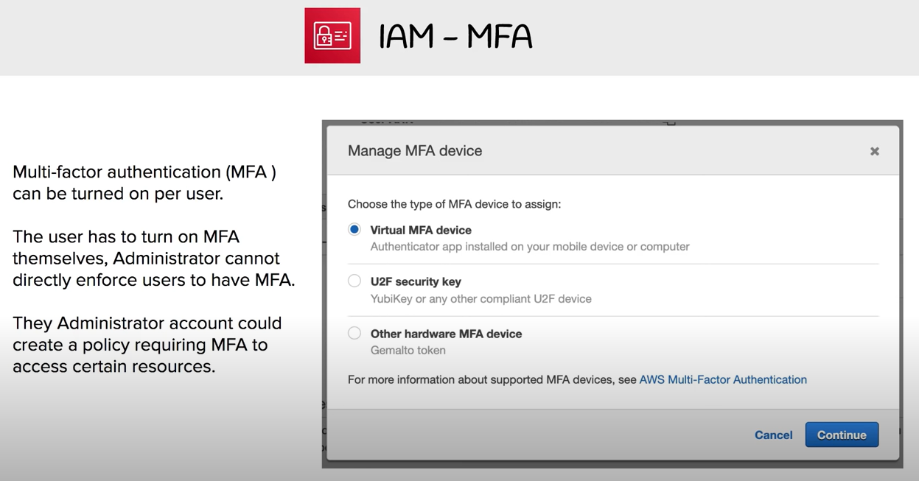

Slide 25
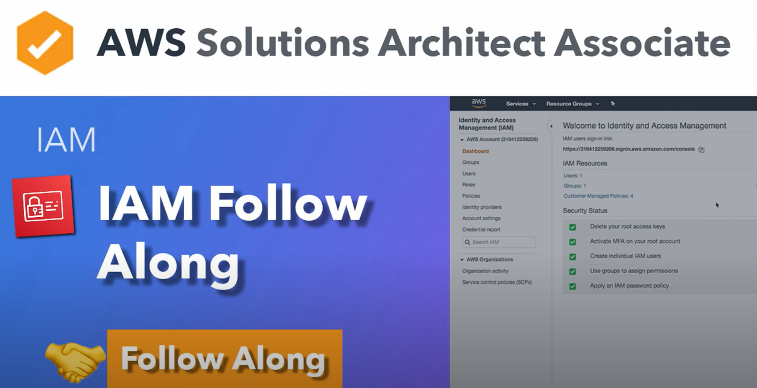

Slide 26
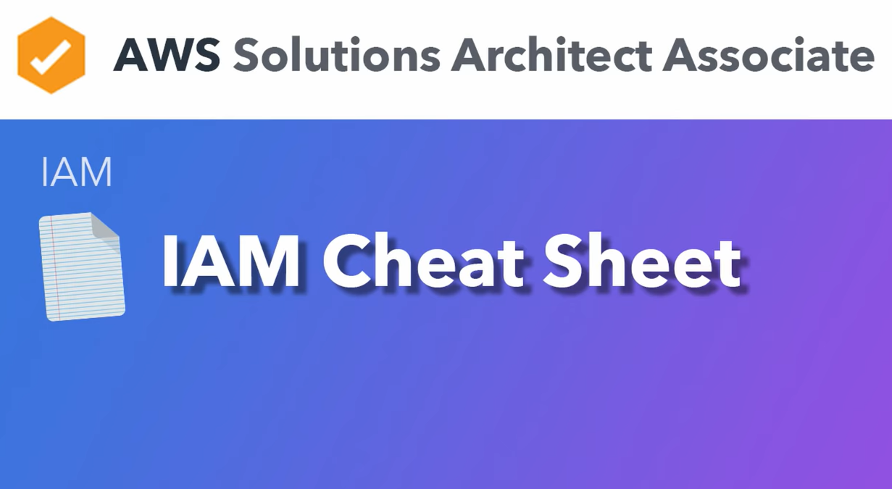

Slide 27
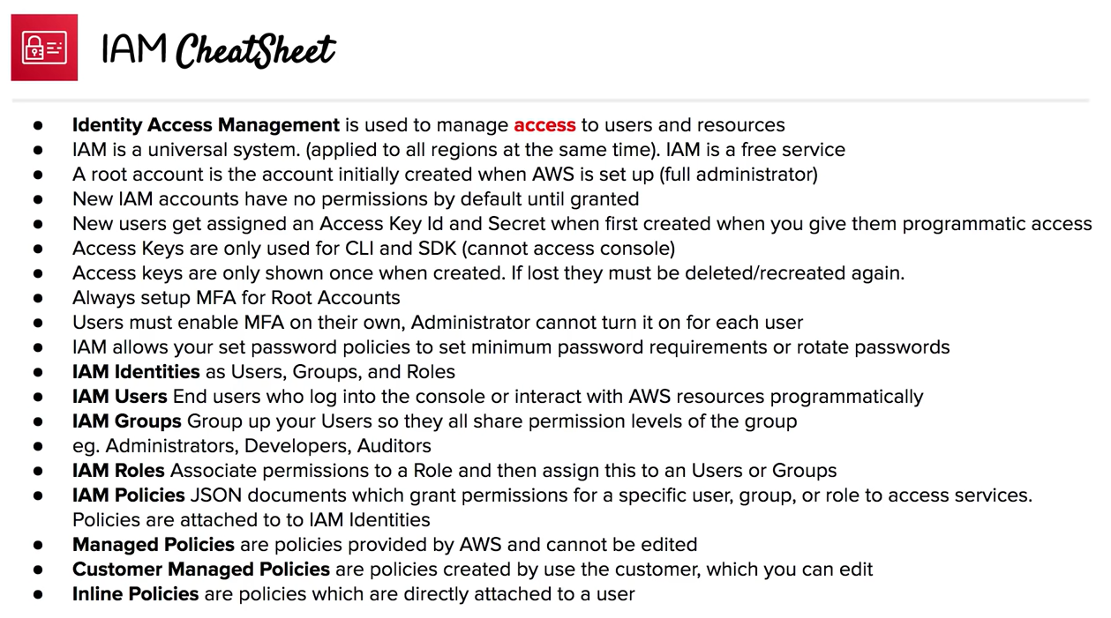

Slide 28


Slide 29
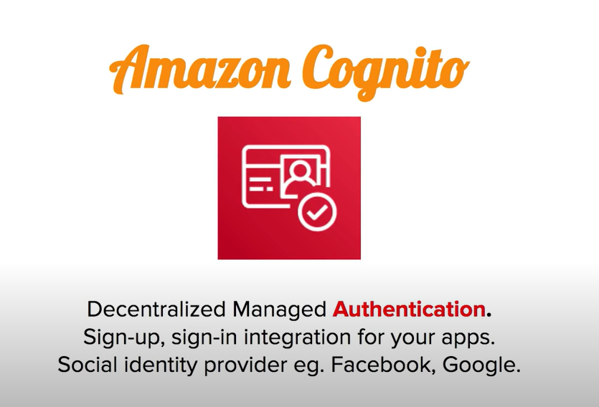

Slide 30
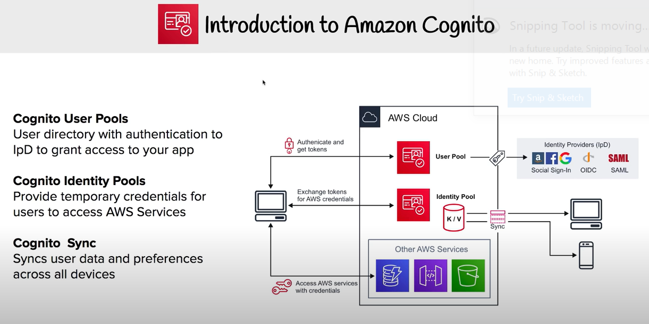

Slide 31
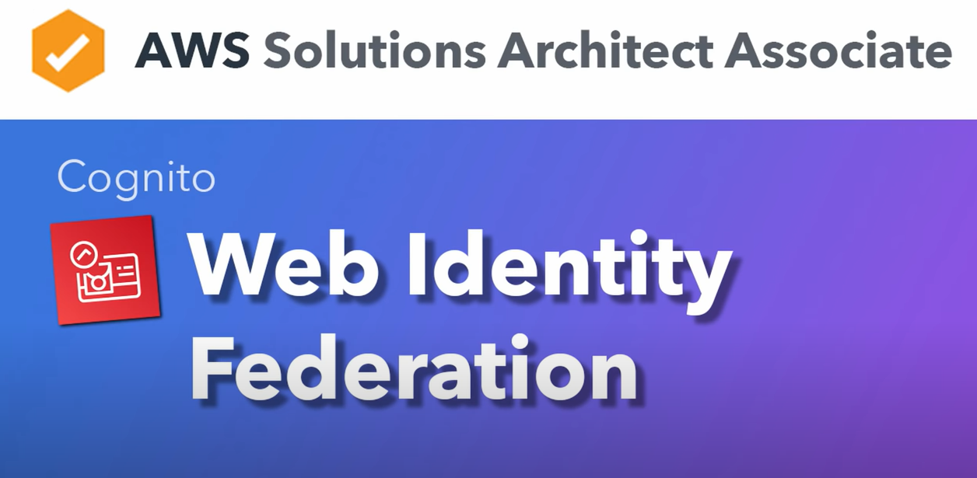

Slide 32
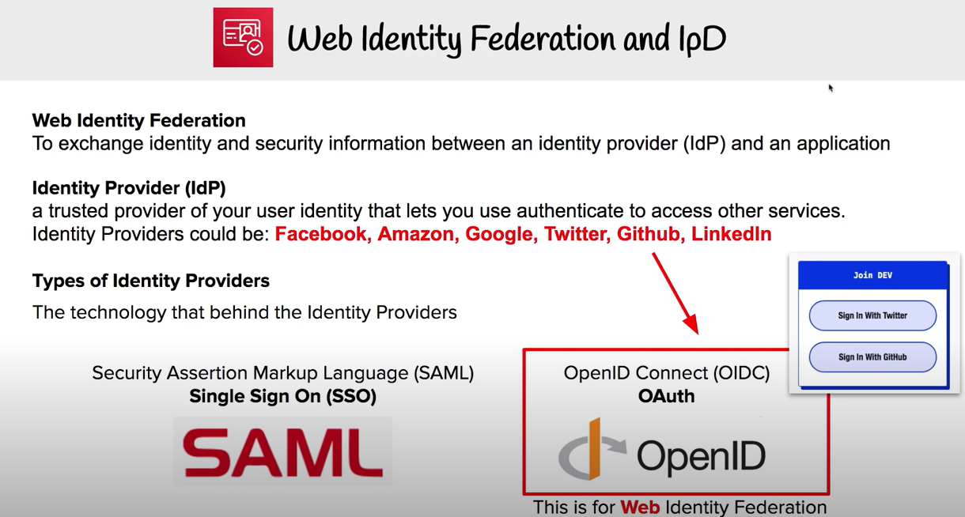

Slide 33


Slide 34
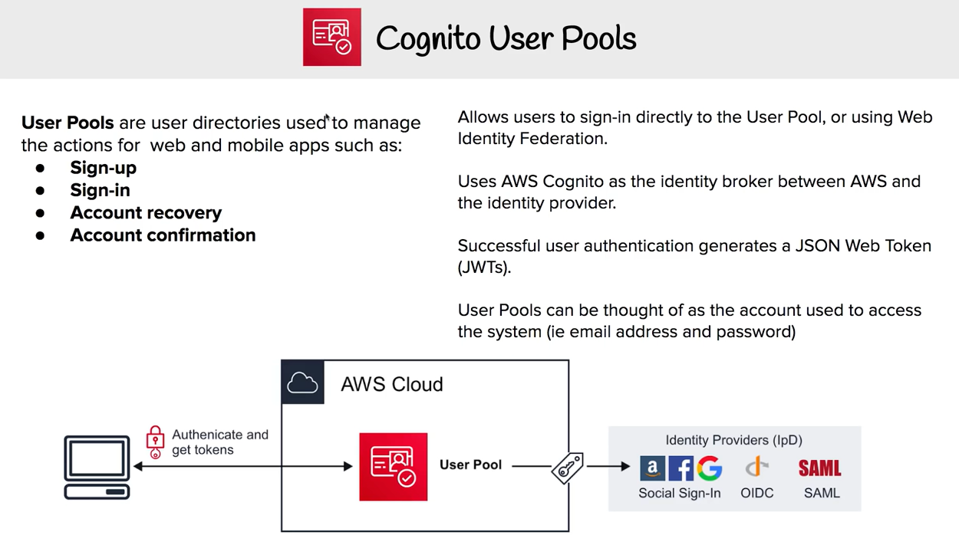

Slide 35
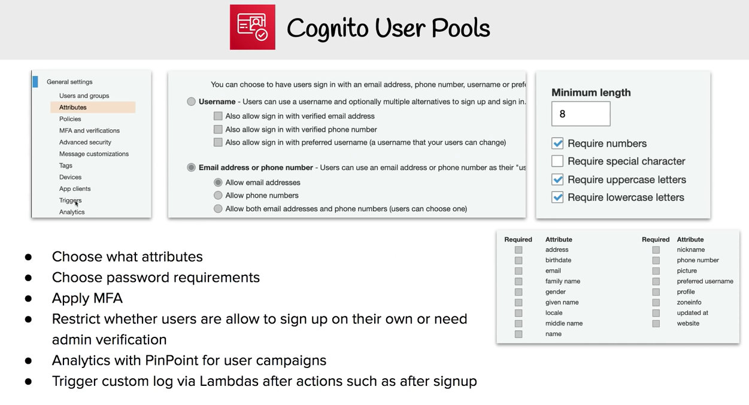

Slide 36
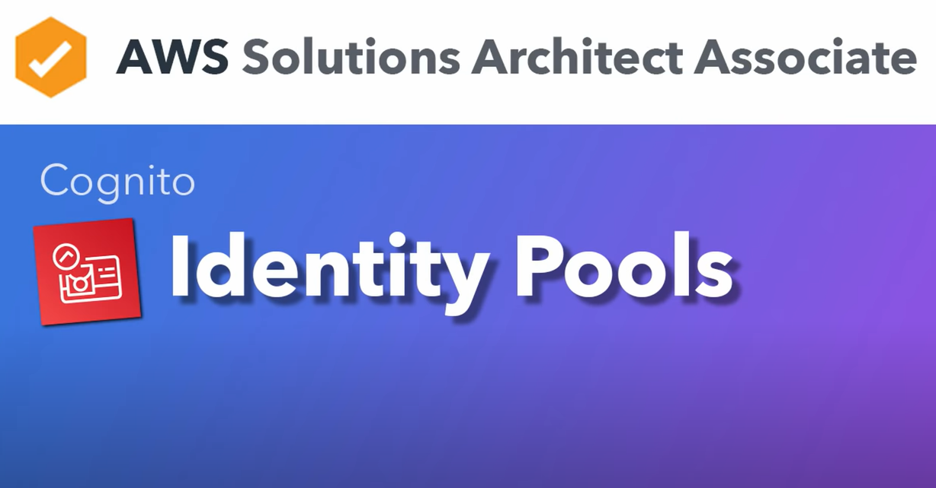

Slide 37
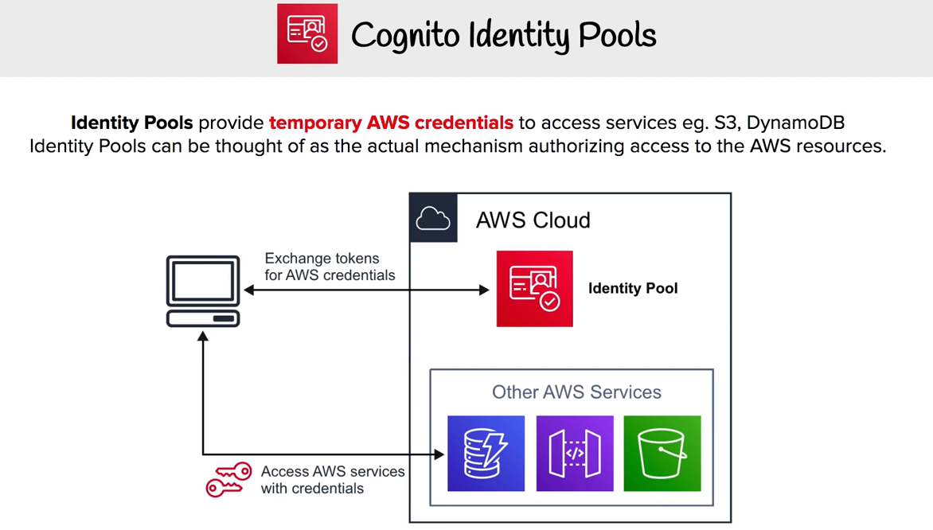

Slide 38
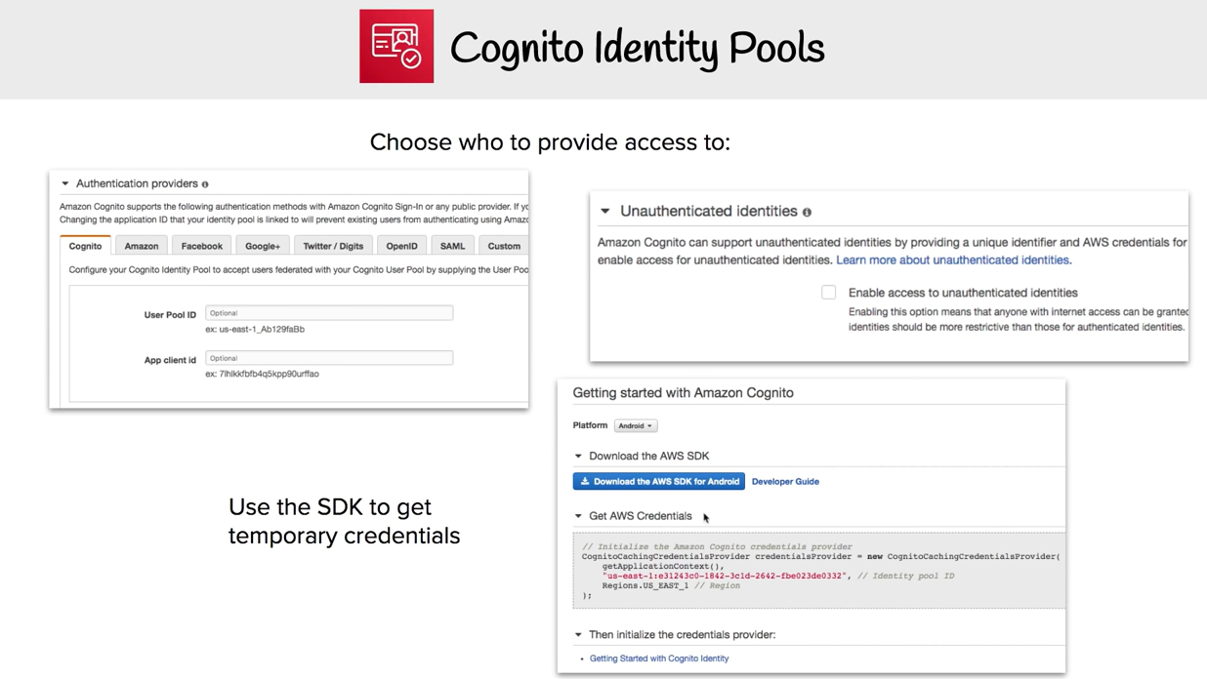

Slide 39
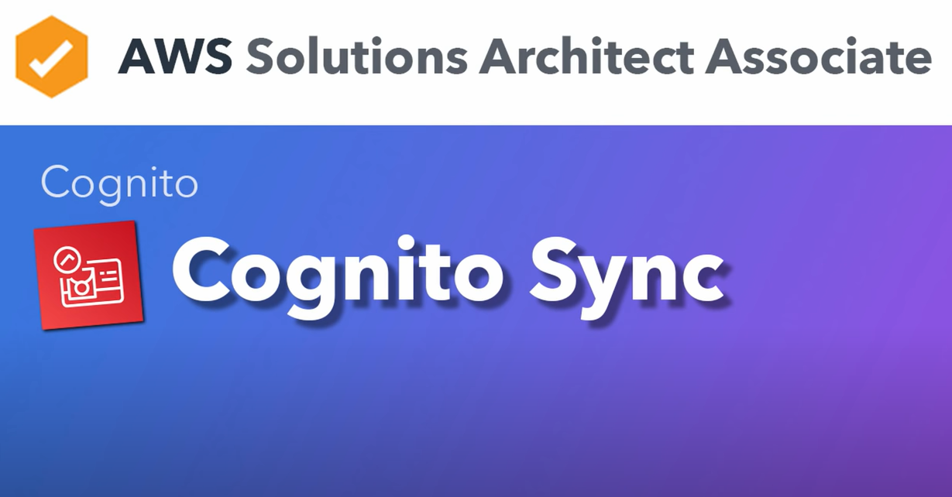

Slide 40
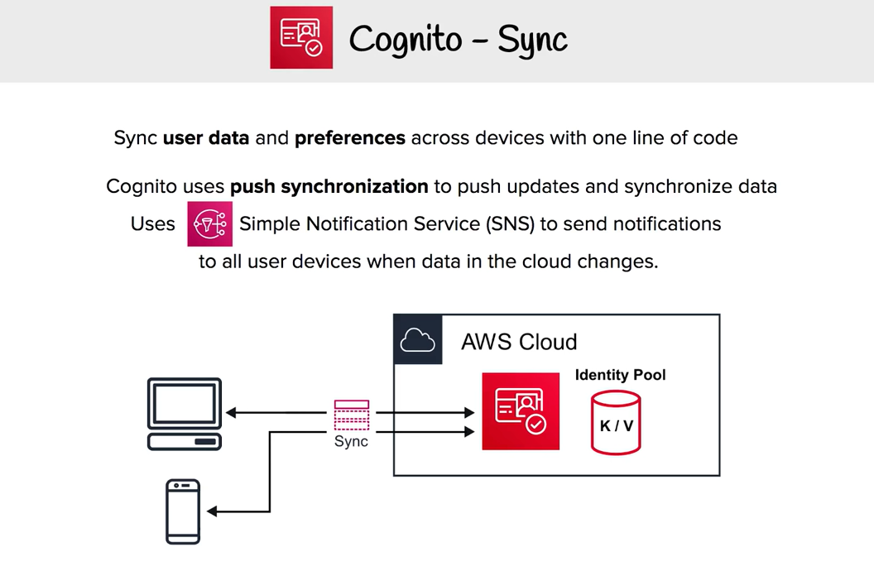

Slide 41


Slide 42
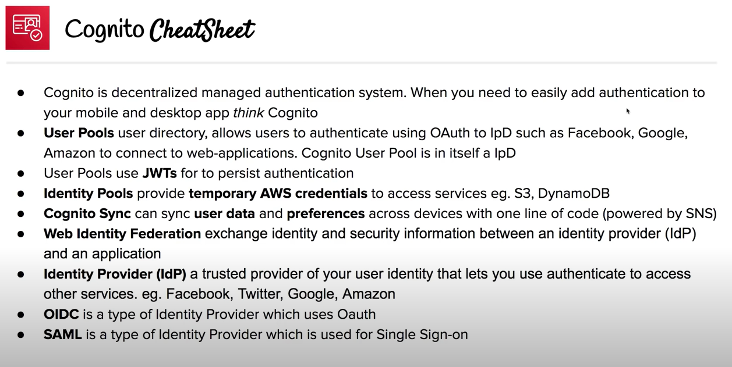

Slide 43
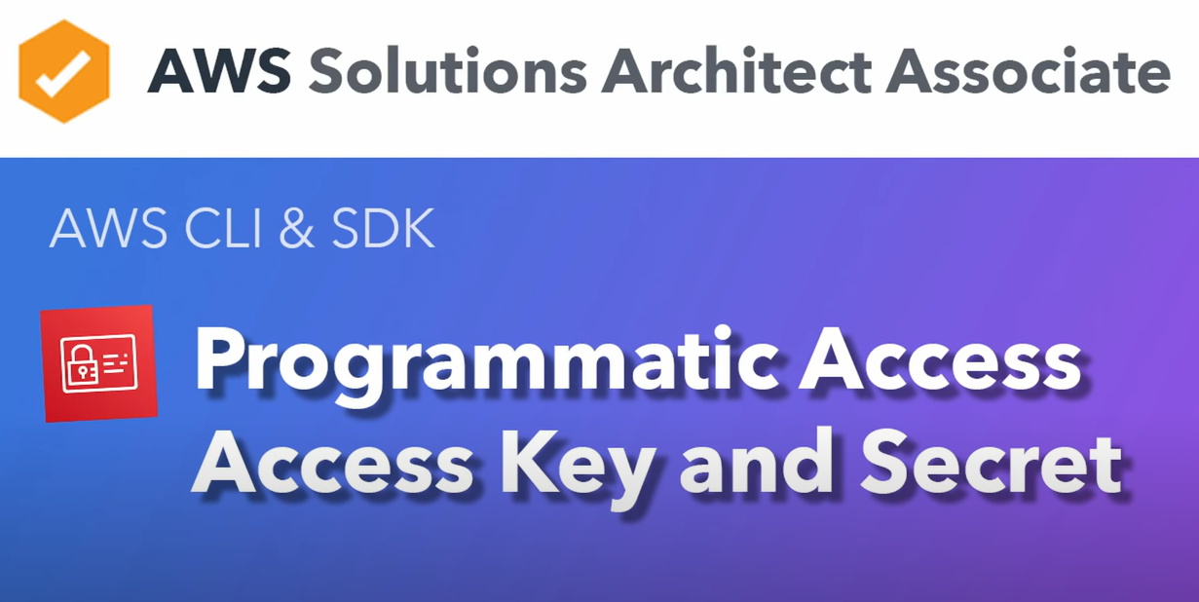

Slide 44
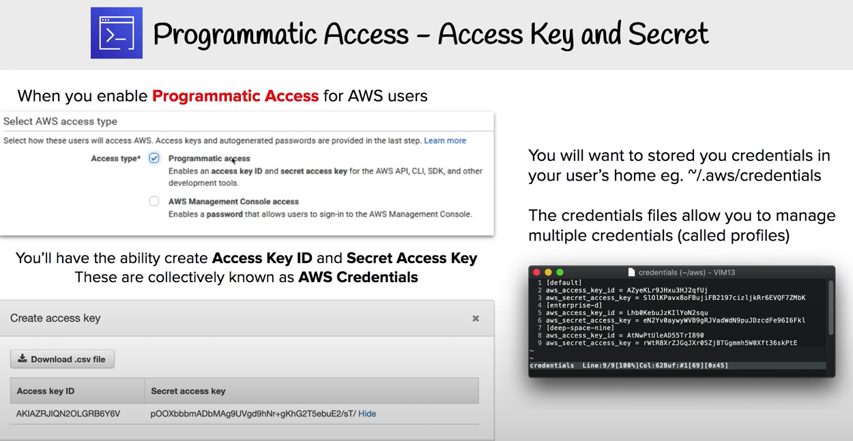

Slide 45
